Slide 1

Smart Agriculture System
Using IOT
Submitted By : Suryansh Choudhary

Slide 2
AIM
Real time Temperature, Humidity and Soil Moisture monitoring
Real time Weather forecast updates
Remote control of motor pumps

Slide 3
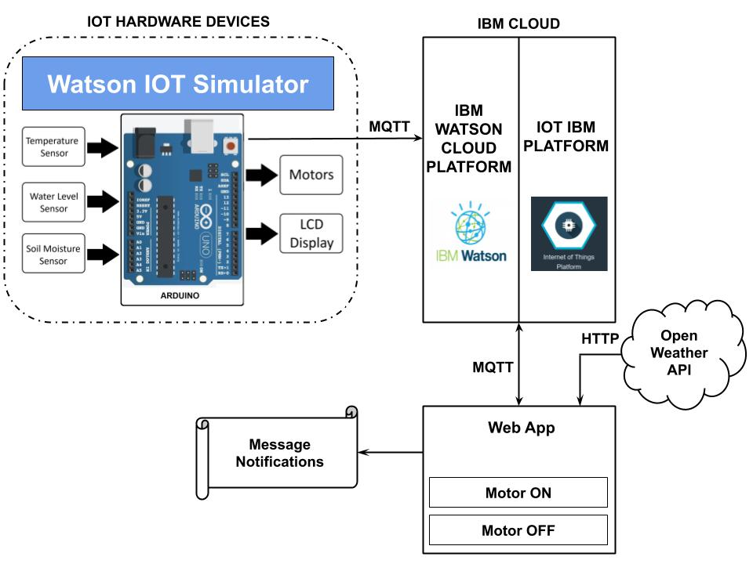
Development
Project is developed using the Watson IoT Platform and NodeRed Software
The data is received from the Watson IoT Simulator and Open Weather API and sent to NodeRed and displayed in UI
Block Diagram

Slide 4
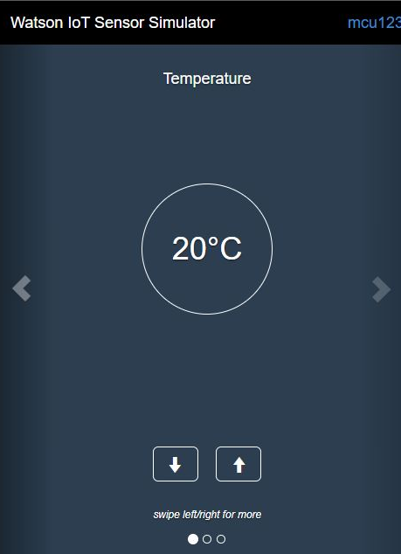
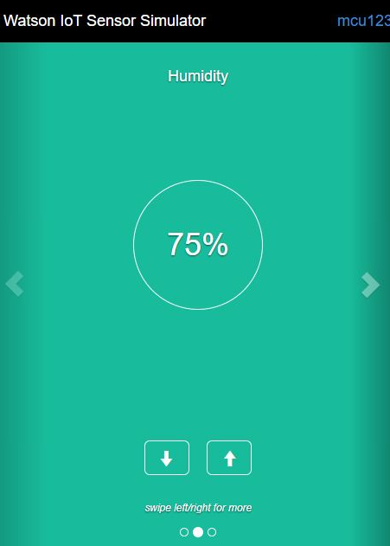
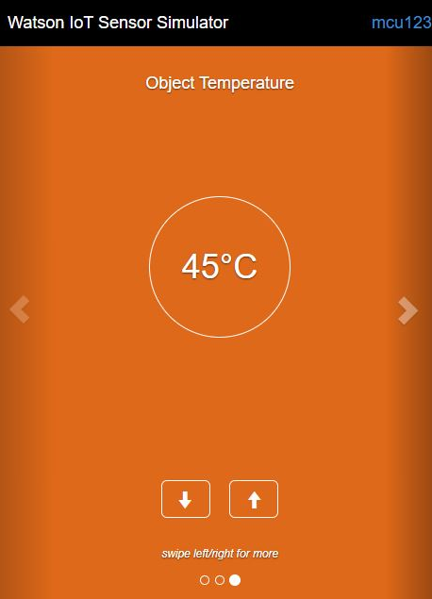
Working
Two devices are created in the Watson IoT Platform, first for receiving sensor information from Watson IoT Simulator and second to connect to motor for receiving commands.
Watson IoT Simulator is connected to the platform to display the sensor data.
Temperature
Humidity
Soil Moisture

Slide 5
An API is generated from the website openweathermaps.org to receive the current weather conditions of a particular place which is selected.
In the node-red, nodes are connected accordingly to receive the data from the Watson IoT Sensor and display it in UI using gauges.
A SMS is send out to the user whenever the soil moisture gets low.
A python code is written for the connecting the motor device. Using the motor device two buttons are generated for the on and off of the motor.
A timer is connected to the motor buttons which sends a SMS to the user mobile after 30 minutes of running and automatically switches the motor off after 45 minutes of continuous running and sends a SMS regarding it to the user.
Nodes are also connected to display the weather conditions using the http request node and the generated API key. Finally the generated UI consists of the simulated data, buttons to control the motor and the weather conditions from the open weather API in the form of gauges.

Slide 6
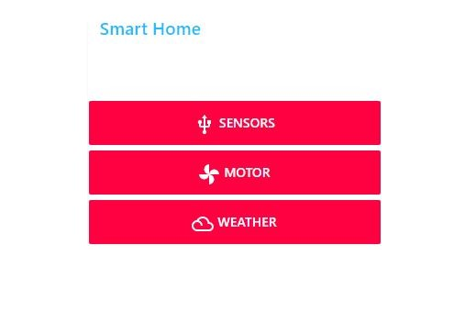
Smart Home Tab
A central console in the UI allows the user to go the desired tab at the click of a button.

Slide 7
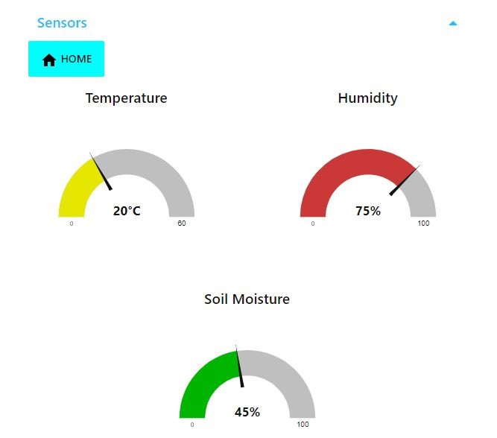
Sensors Tab
The Temperature, Humidity and Soil Moisture levels are displayed as gauges.
Each gauge has been configured to show 3 conditions: Yellow - Good Green - Ideal Red - Danger

Slide 8
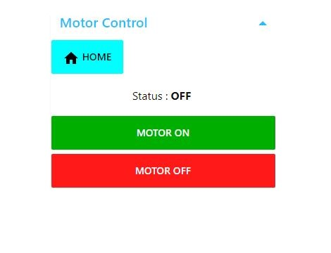
Motor Tab
The motor controls allow the user to switch the motor on and off.
A SMS is sent after 30 minutes warning the user.
The timer automatically switches off the motor and sends a SMS after 45 minutes.

Slide 9
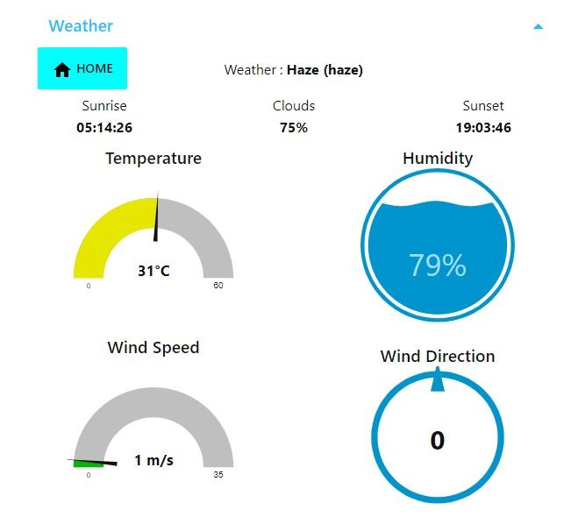
Weather Tab
Live weather stats of the are displayed by the help of gauges and texts.
The weather data is refreshed every 5 seconds making it very accurate.

Slide 10
Conclusion
An application has been made to monitor soil conditions and climatic conditions and to control motors remotely.
The application made is most likely to work great in real-life scenario.
The User Interface of the application is made simple allowing it to be used by everyone.

